Slide 1
Chapter 9 Molecular Geometries and Bonding Theories

Slide 2
Molecular Shapes
The shape of a molecule plays an important role in its reactivity.
By noting the number of bonding and nonbonding electron pairs we can easily predict the shape of the molecule.

Slide 3
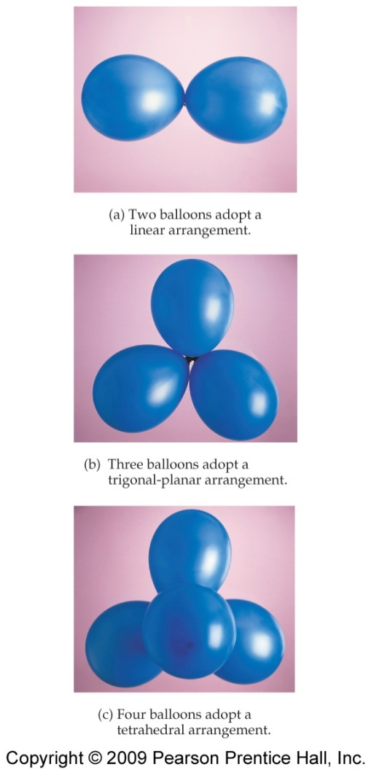
What Determines the Shape of a Molecule?
or lone pair
By assuming the electron pairs (bonding or nonbonding) are placed as far as possible from each other, we can predict the shape of the molecule.
Notes:
Electron pairs, whether they be bonding or nonbonding, repel each other.

Slide 4
Electron Domains
Electron pairs are referred as electron domains.
A double or a triple bond counts as one electron domain.
The central atom in this molecule, A, has four electron domains.
Notes:
We can refer to the electron pairs as electron domains.
In a double or triple bond, all electrons shared between those two atoms are on the same side of the central atom; therefore, they count as one electron domain.

Slide 5
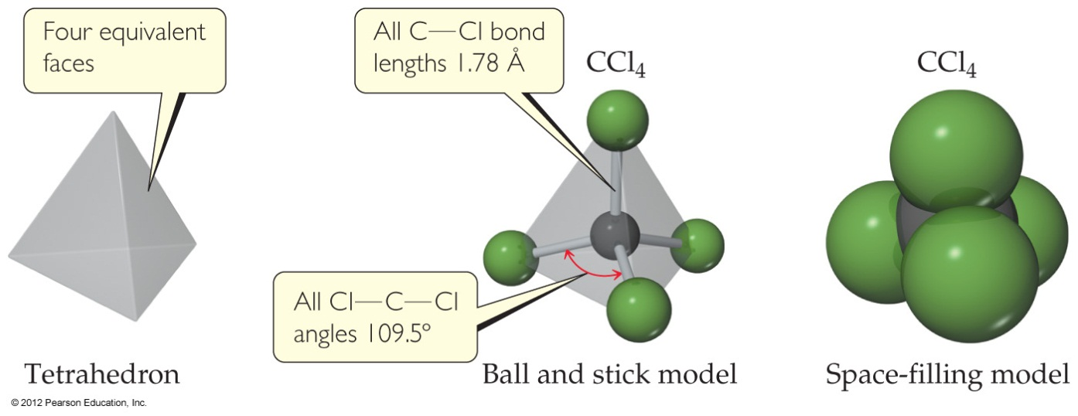
Valence Shell Electron Pair Repulsion Theory (VSEPR)
“The best arrangement of a given number of electron domains is the one that minimizes the repulsions among them.”

Slide 6
Electron-Domain Geometries
Notes:
These are the electron-domain geometries for two through six electron domains around a central atom.

Slide 7
Electron-Domain Geometries
H
Count the number of electron domains in the Lewis structure.
The geometry will be that which corresponds to the number of electron domains.
H
|
C
C

Slide 8
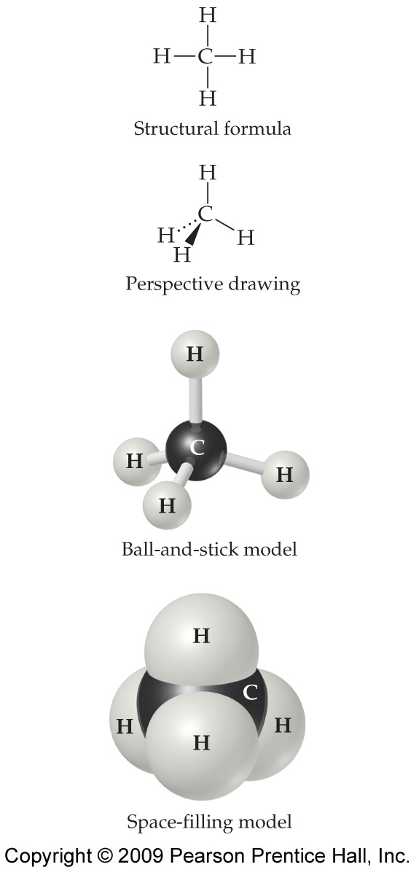
Molecular Geometries
H
H
|
C
C
CH₄
Molecular geometry (tetrahedral)
The electron-domain geometry is often not the shape of the molecule, however.
The molecular geometry is that defined by the positions of only the atoms in the molecules, not the nonbonding pairs.

Slide 9
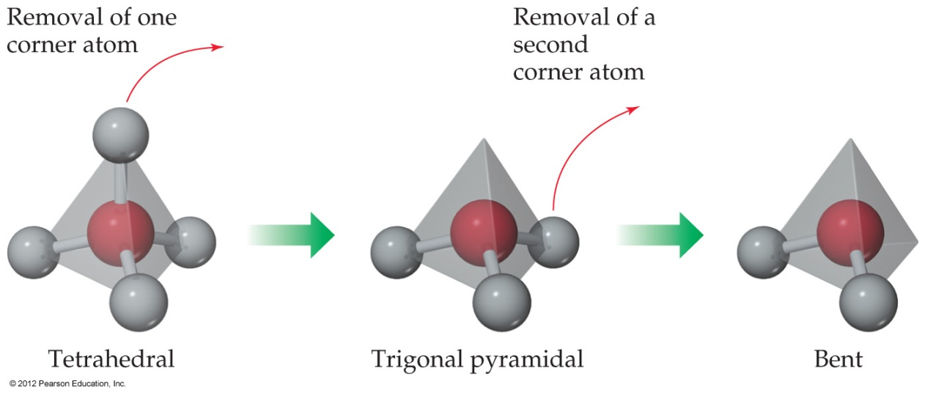
Molecular Geometries
Within each electron domain, then, there might be more than one molecular geometry.
Notes:
Molecular geometry may be different from electron-domain geometry, depending on what types of electron-domains in the molecular, bonding or nonbonding.

Slide 10
Predict the Shape of Molecules
To predict the shape of molecules:
Draw a Lewis structure
Determine the number of electron domains around the central atom, and identify each as bonding domains or nonbonding domains.
Establish the electron-domain geometry based on all electron domains.
Determine molecular geometry based on positions of bonding domains.
Notes:
Molecular geometry may be different from electron-domain geometry, depending on what types of electron-domains in the molecular, bonding or nonbonding.

Slide 11
Linear Electron Domain
In the linear domain, there is only one molecular geometry: linear.
NOTE: If there are only two atoms in the molecule, the molecule will be linear no matter what the electron domain is.

Slide 12
Trigonal Planar Electron Domain
There are two molecular geometries:
Trigonal planar, if all the electron domains are bonding,
Bent, if one of the domains is a nonbonding pair.

Slide 13
Tetrahedral Electron Domain
There are three molecular geometries:
Tetrahedral, if all are bonding pairs,
Trigonal pyramidal if one is a nonbonding pair,
Bent if there are two nonbonding pairs.

Slide 14
Nonbonding Pairs and Bond Angle
Nonbonding pairs are physically larger than bonding pairs. (Requires more space.)
Therefore, their repulsions are greater; this tends to decrease bond angles in a molecule.

Slide 15
Multiple Bonds and Bond Angles
Multiple bonds place greater electron density on one side of the central atom than do single bonds.
Therefore, they also affect bond angles.

Slide 16
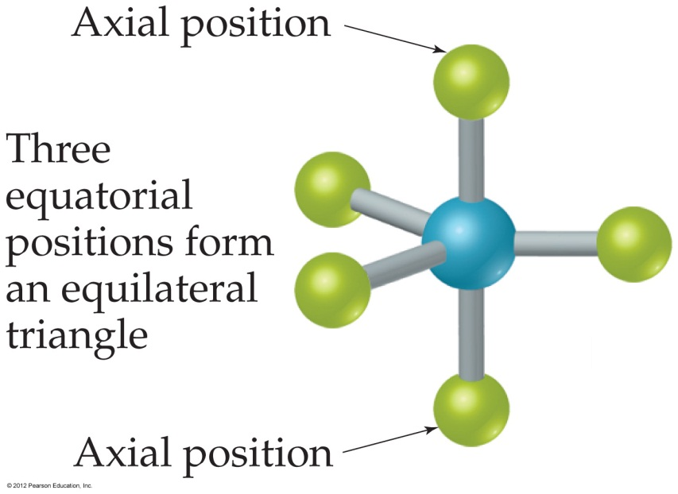
Trigonal Bipyramidal Electron Domain
There are two distinct positions in this geometry:
Axial
Equatorial

Slide 17
Trigonal Bipyramidal Electron Domain
Lower-energy conformations result from having nonbonding electron pairs in equatorial, rather than axial, positions in this geometry.

Slide 18
Trigonal Bipyramidal Electron Domain
There are four distinct molecular geometries in this domain:
Trigonal bipyramidal
Seesaw
T-shaped
Linear

Slide 19
Octahedral Electron Domain
All positions are equivalent in the octahedral domain.
There are three molecular geometries:
Octahedral
Square pyramidal
Square planar

Slide 20
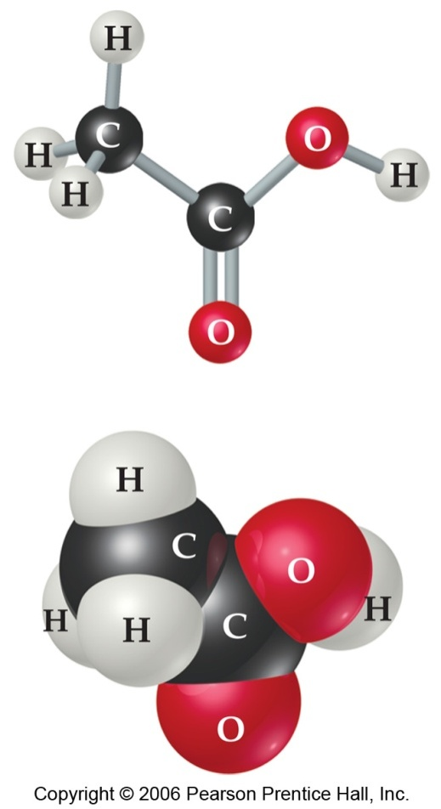
Larger Molecules
In larger molecules, we look at the geometry about a particular atom rather than the geometry of the molecule as a whole.
Notes:
This approach makes sense, especially because larger molecules tend to react at a particular site in the molecule.

Slide 21
Predict the Shape of Molecules
Example
Use the VSEPR method to predict the molecular geometry of NO₂⁻, SiCl₄, ClF₃.

Slide 22
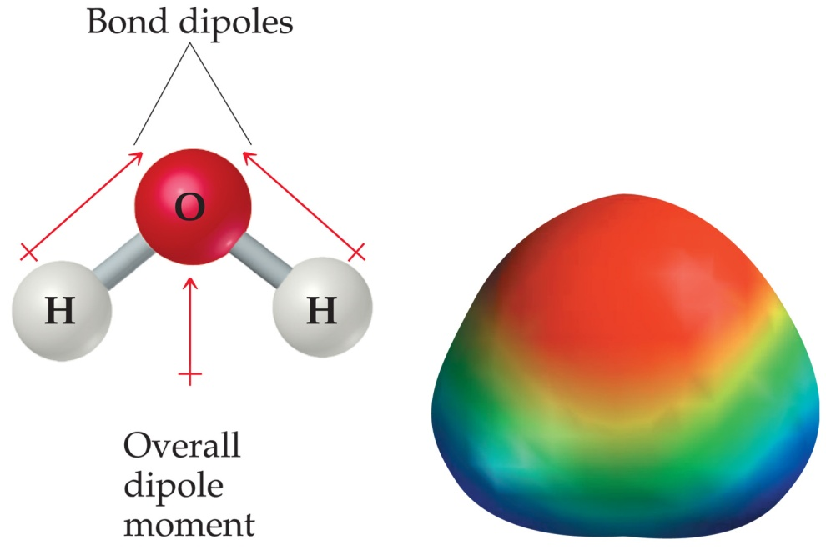
Polarity
For a molecule with two atoms, polarity of the molecule is the polarity of the bond.
For molecule with more than two atoms, the polarity of molecule depends on both polarity of bonds and geometry of the molecule.
Notes:
In Chapter 8 we discussed bond dipoles.
If a molecule has no polar bonds, the molecule is nonpolar.
But just because a molecule possesses polar bonds does not mean the molecule as a whole will be polar.
By adding the individual bond dipoles, one can determine the overall dipole moment for the molecule.
Bond dipoles and dipole moments are vector quantities. They have both a magnitude and a direction. Both the magnitudes and directions of the bond dipoles must be considered when summing these vectors.

Slide 23
Polarity
To predict the polarity of molecules:
Draw a Lewis structure.
Use VSEPR theory to predict molecular shape.
Use electronegativity values to predict bond dipoles
Determine polarity of a molecule based on overall dipole moment of the molecule.
Notes:
In Chapter 8 we discussed bond dipoles.
But just because a molecule possesses polar bonds does not mean the molecule as a whole will be polar.
By adding the individual bond dipoles, one can determine the overall dipole moment for the molecule.

Slide 24
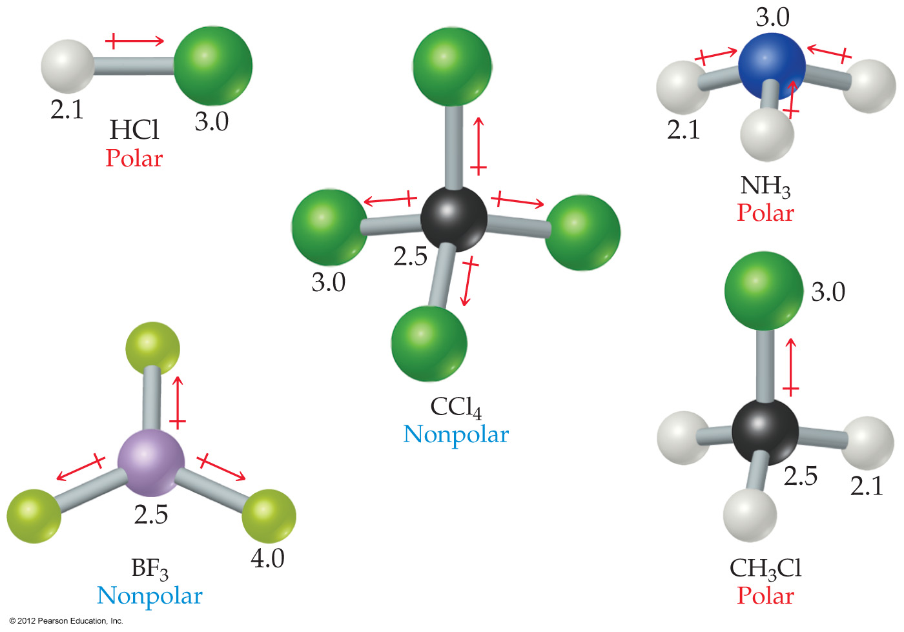
Polarity
polar
polar
nonpolar
nonpolar
polar

Slide 25
Valence Bond Theory
We think of covalent bonds forming through the sharing of electrons by adjacent atoms.
In such an approach this can only occur when orbitals on the two atoms overlap.
Valence bond theory states that a covalent bond is formed when atomic orbitals overlap.
Notes:
The VSEPR model provides a simple way to predict the shapes of molecules. However, it does not explain why bonds exist between atoms.
How can we use atomic orbitals to explain bonding and to account for the geometries of molecules?
In general, the greater the overlap between two orbitals, the stronger is the bond between two atoms.

Slide 26
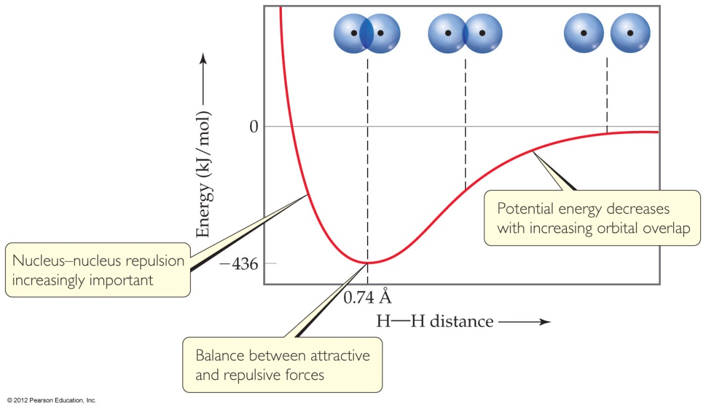
Overlap and Bonding
Increased overlap brings the electrons and nuclei closer together while simultaneously decreasing electron-electron repulsion.
However, if atoms get too close, the internuclear repulsion greatly raises the energy.

Slide 27
How to Explain Molecular Geometries?
But it’s hard to imagine tetrahedral, trigonal bipyramidal, and other geometries arising from the atomic orbitals we recognize.

Slide 28
Hybridization of Atomic Orbitals
We assume that the atomic orbitals on an atom mix to form new orbitals called hybrid orbitals.
The shapes of any hybrid orbital is different from shapes of the original atomic orbitals.
The number of hybrid orbitals equals the number of atomic orbitals that are mixed.
The process of mixing atomic orbitals is called hybridization.
Notes:
Let’s examine the common types of hybridization.

Slide 29
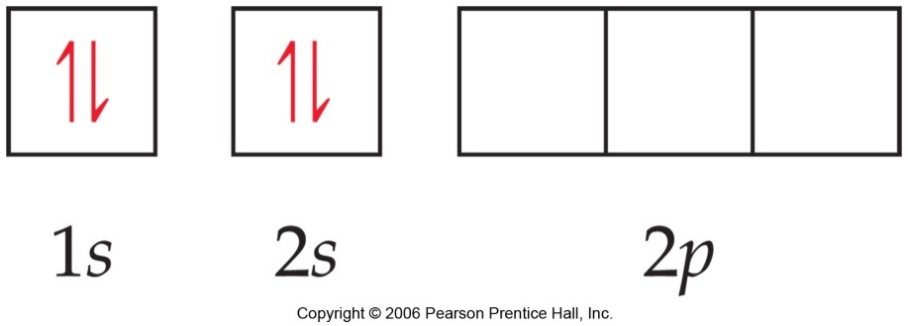
sp Hybrid Orbitals
Consider beryllium:
In its ground electronic state, it would not be able to form bonds because it has no singly-occupied orbitals.
Consider beryllium:
In its ground electronic state, it would not be able to form bonds because it has no singly-occupied orbitals.
But if it absorbs the small amount of energy needed to promote an electron from the 2s to the 2p orbital, it can form two bonds.

Slide 30
sp Hybrid Orbitals
Mixing the s and p orbitals yields two degenerate orbitals that are hybrids of the two orbitals.
These sp hybrid orbitals have two lobes like a p orbital.
One of the lobes is larger and more rounded as is the s orbital.
Notes:
The shapes of any hybrid orbital is different from shapes of the original atomic orbitals.
The number of hybrid orbitals equals the number of atomic orbitals that are mixed - 2.

Slide 31
sp Hybrid Orbitals
These two degenerate orbitals would align themselves 180° from each other.
This is consistent with the observed geometry of beryllium compounds: linear.

Slide 32
sp Hybrid Orbitals
With hybrid orbitals the orbital diagram for beryllium would look like this.
The sp orbitals are higher in energy than the 1s orbital but lower than the 2p.

Slide 33
sp² Hybrid Orbitals
Using a similar model for boron leads to…

Slide 34
sp² Hybrid Orbitals
…three degenerate sp² orbitals.
Notes:
The shapes of any hybrid orbital is different from shapes of the original atomic orbitals.
The number of hybrid orbitals equals the number of atomic orbitals that are mixed - 3.

Slide 35
sp³ Hybrid Orbitals
With carbon we get…

Slide 36
sp³ Hybrid Orbitals
…four degenerate
sp³ orbitals.
s-p hybridization
Notes:
The shapes of any hybrid orbital is different from shapes of the original atomic orbitals.
The number of hybrid orbitals equals the number of atomic orbitals that are mixed - 4.

Slide 37
Hybridization Involving d Orbitals
For geometries involving expanded octets on the central atom, we must use d orbitals in our hybrids.

Slide 38
Hybridization Involving d Orbitals
This leads to five degenerate sp³d orbitals…
…or six degenerate sp³d² orbitals.

Slide 39
Hybrid Orbitals
Once you know the electron-domain geometry, you know the hybridization state of the atom.
Notes:
Electron-domain geometry implies type of hybridization.
The shapes of any hybrid orbital is different from shapes of the original atomic orbitals.
The number of hybrid orbitals equals the number of atomic orbitals that are mixed.
A molecular structure is determined by experiment. VSEPR model predicts molecular shape quite successfully. Hybridization is just a way to rationalize that structure.

Slide 40
Hybrid Orbital Summary
Draw Lewis structure for molecule or ion.
Determine electron-domain geometry using VSEPR model.
Specify the hybrid orbitals needed to accommodate the electron pairs based on their geometry arrangement (Table 9.4).
Notes:
Notice that hybridization is based on electron-domain geometry, not molecular geometry.

Slide 41
Example
Predict the hybridization of the central atom in
(a) SO₃²⁻ (b) SF₆.

Slide 42
Valence Bond Theory
Hybridization is a major player in this approach to bonding.
There are two ways orbitals can overlap to form bonds between atoms.

Slide 43
Sigma (σ) Bonds
Sigma (σ) bonds are characterized by
Head-to-head overlap.
Cylindrical symmetry of electron density about the internuclear axis.

Slide 44
Pi (π) Bonds
Pi (π) bonds are characterized by
Side-to-side overlap.
Electron density above and below the internuclear axis.
Notes:
π Bond has less orbital overlaps than σ bond, thus is weaker than σ bond.

Slide 45
Single Bonds
Single bonds are always σ bonds, because σ overlap is greater, resulting in a stronger bond and more energy lowering.

Slide 46
Multiple Bonds
In a multiple bond one of the bonds is a σ bond and the rest are π bonds.

Slide 47
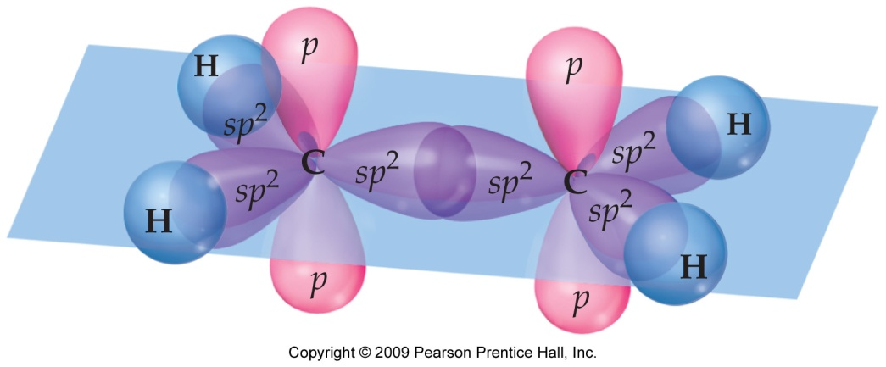
Multiple Bonds
H H C = C H H
In ethylene, C₂H₄, σ bond is formed from sp² orbitals on the carbon atoms.
The unhybridized 2p orbitals on C atoms are used to make a π bond.

Slide 48
Multiple Bonds
In triple bonds, as in acetylene (C₂H₂), two sp orbitals form a σ bond between the carbons, and two pairs of p orbitals overlap in π fashion to form the two π bonds.
H – C C – H

Slide 49
Delocalized Electrons: Resonance
When writing Lewis structures for species like the nitrate ion, we draw resonance structures to more accurately reflect the structure of the molecule or ion.

Slide 50
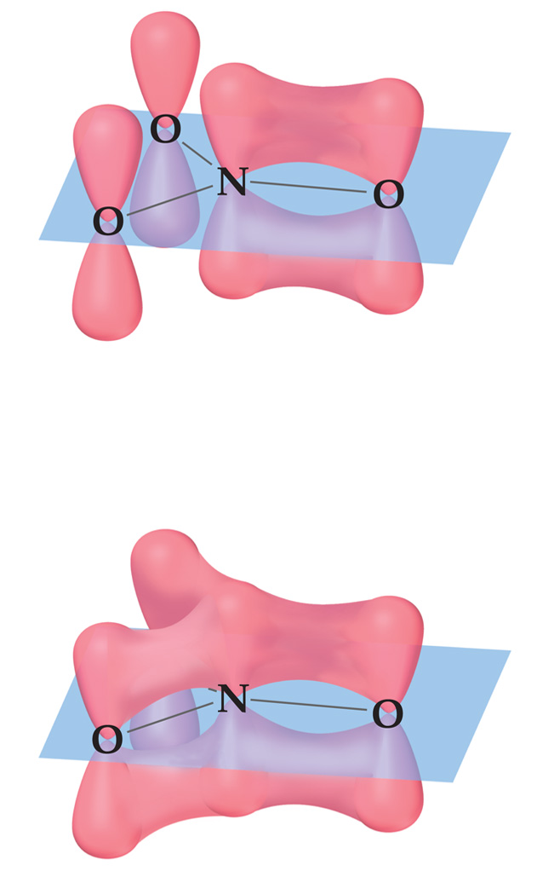
Delocalized Electrons: Resonance
In reality, each of the four atoms in the nitrate ion has a p orbital.
The p orbitals on all three oxygens overlap with the p orbital on the central nitrogen.
This means the π electrons are not localized between the nitrogen and one of the oxygens, but rather are delocalized throughout the ion.
N-O π bond
Delocalized π bond

Slide 51
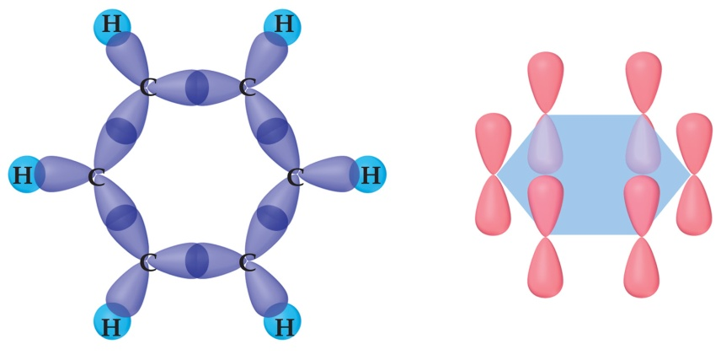
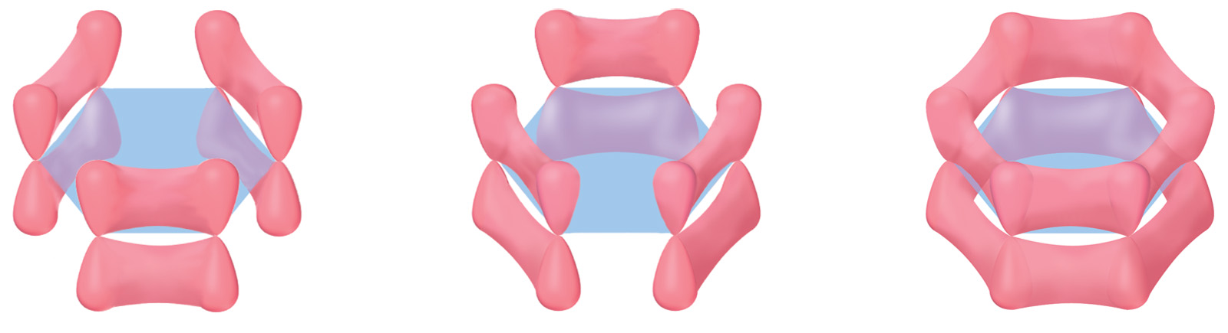
Resonance
The organic molecule benzene has six σ bonds and a p orbital on each carbon atom.
σ bonds 2p atomic orbitals
localized localized π bonds π bonds

Slide 52
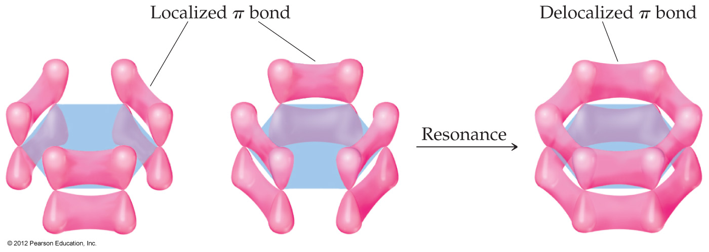
Resonance
In reality the π electrons in benzene are not localized, but delocalized.
The even distribution of the π electrons in benzene makes the molecule unusually stable.

Slide 53
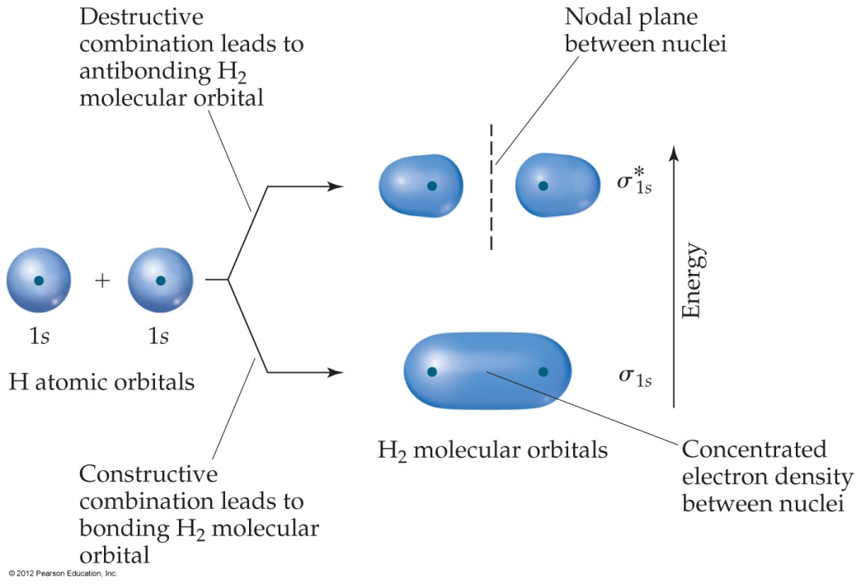
Molecular-Orbital (MO) Theory
In MO theory, we invoke the wave nature of electrons.
If waves interact constructively, the resulting orbital is lower in energy: a bonding molecular orbital.
If waves interact destructively, the resulting orbital is higher in energy: an antibonding molecular orbital.

Slide 54
Molecular Orbital Diagram
The relative energies of molecular orbitals are represented by an energy-level diagram (also called molecular orbital diagram).
Bonding orbitals and antibonding orbitals
Bonding electrons and antibonding electrons
Each MO can accommodate two electrons with opposite spin.
Molecular orbital diagram
or
Energy-level diagram

Slide 55
Electron Configuration for Molecules
In H₂ the two electrons go into the bonding molecular orbital σ_{1s}.
Electron configuration for H₂ is
(σ_{1s})²
Molecular orbital diagram
or
Energy-level diagram

Slide 56
Bond Order
Bond order =
½ (no. of bonding electrons –
no. of antibonding electrons)
Bond order = 1: single bond
Bond order = 2: double bond
Bond order = 3: triple bond
Bond order of ½ is possible.
Molecular orbital diagram
or
Energy-level diagram
Notes:
In MO theory, the stability of a covalent bond is related to its bond order.

Slide 57
MO Diagram, Electron Configuration, and Bond Order for H₂
For hydrogen, H₂
Electron configuration:
(σ_{1s})²
With two electrons in the bonding MO and none in the antibonding MO, the bond order is
1
2
Molecular orbital diagram
or
Energy-level diagram
(2 − 0) = 1

Slide 58
MO Diagram, Electron Configuration, and Bond Order for He₂
In the case of He₂
Electron configuration:
(σ_{2s})²(σ*_{2s} )²
The bond order would be
1
2
(2 − 2) = 0
Therefore, He₂ does not exist.
Molecular orbital diagram
or
Energy-level diagram

Slide 59
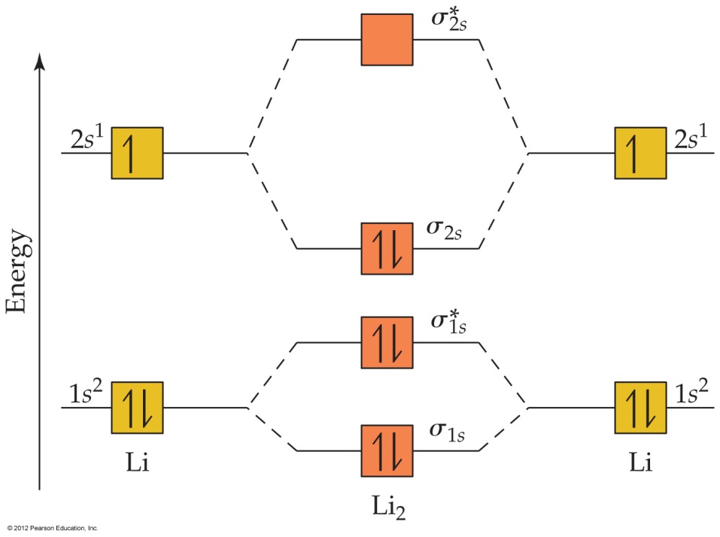
MO Diagram, Electron Configuration, and Bond Order for Li₂
For Li₂, the bond order would be
1
2
(4 − 2) = 1
For Be₂ the bond order would be
1
2
(4 − 4) = 0
Molecular orbital diagram
or
Energy-level diagram
So Be₂ does not exist.
Notes:
Li₂ molecules are found in vapor phase.
We can see here that core electrons usually do not contribute significantly to bonding in molecules. So we can only consider valence electrons in bonding.

Slide 60
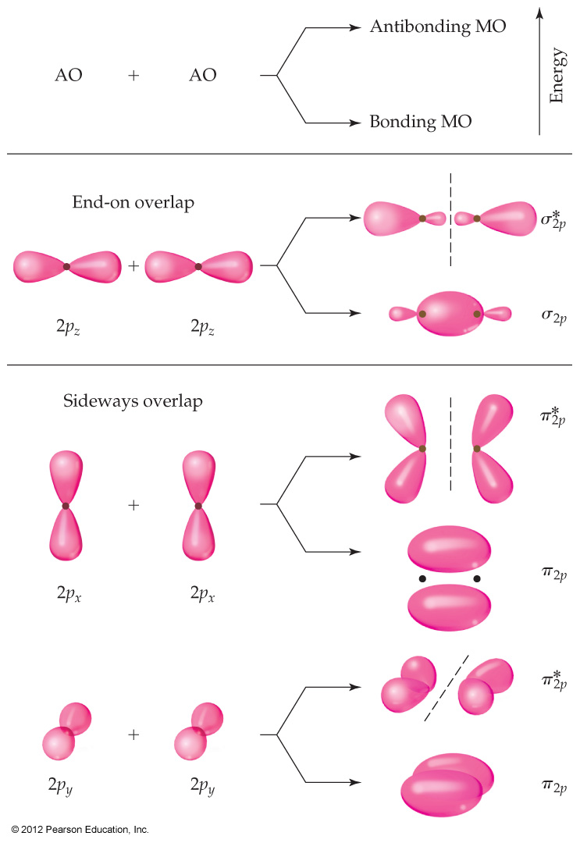
MO Theory
For atoms with both s and p orbitals, there are two types of interactions:
The s and the p orbitals that face each other overlap in σ fashion.
The other two sets of p orbitals overlap in π fashion.

Slide 61
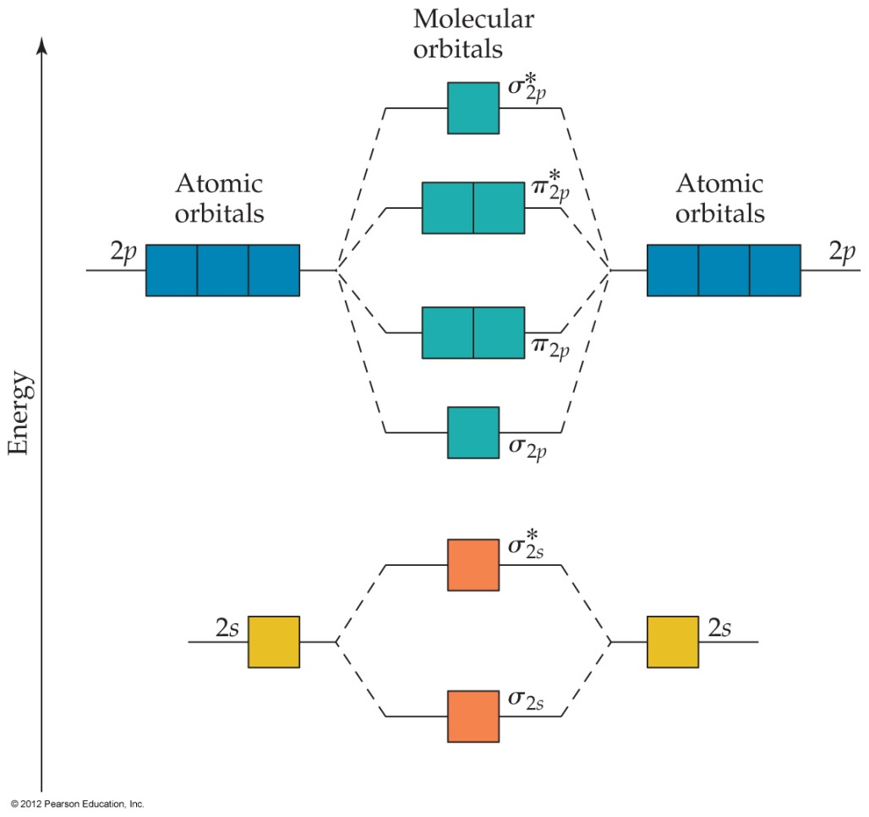
MO Diagram
The resulting MO diagram looks like this.
There are both σ and π bonding molecular orbitals and σ* and π* antibonding molecular orbitals.
Notes:
The number of MOs formed equals the number of atomic orbitals combined.
Atomic orbitals combine most effectively with other atomic orbitals of similar energy.
As the overlap of atomic orbitals increases, the energy of the bonding MO is lowered and the energy of the antibonding MO is raised.
Each MO can accommodate two electrons with opposite spin (Pauli exclusion principle).
When Mos of the same energy are populated, one electron enters each orbital (with the same spin) before spin paring occurs (Hund’s rule)

Slide 62
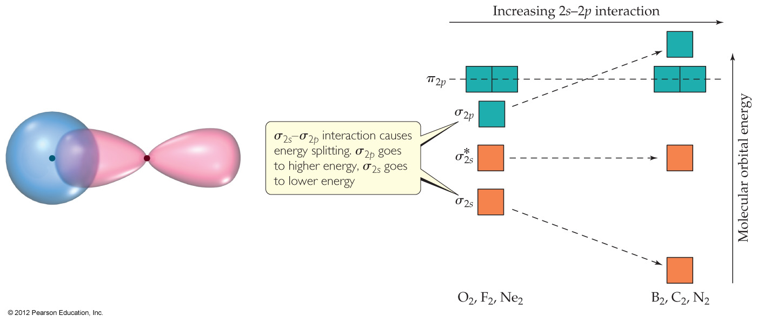
MO Theory
The smaller p-block elements in the second period have a sizable interaction between the s and p orbitals.
This flips the order of the σ and π molecular orbitals in these elements.

Slide 63
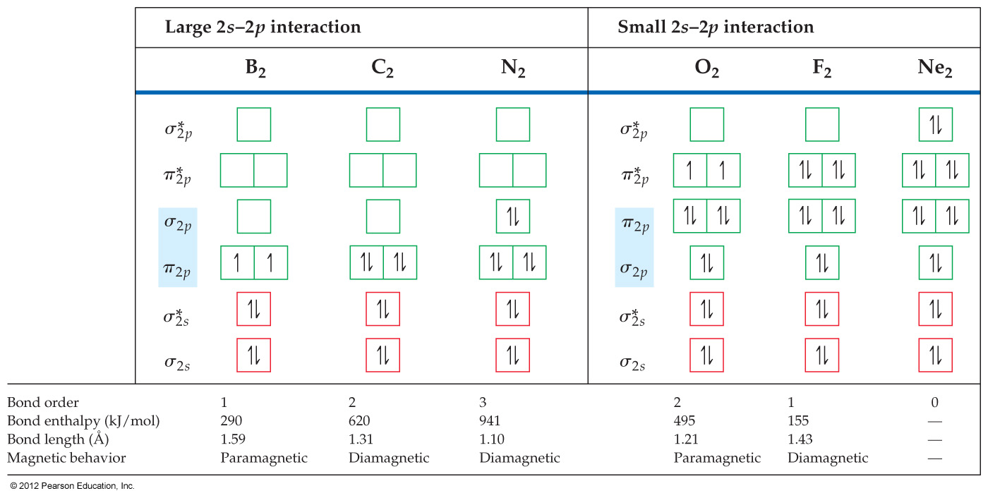
Second-Row MO Diagrams
Notes:
Though valence bond theory effectively conveys most observed properties of ions and molecules, there are some concepts better represented by molecular orbitals.
From MO theory, O₂ has two unparied electrons and is paramagnetic.

Slide 64
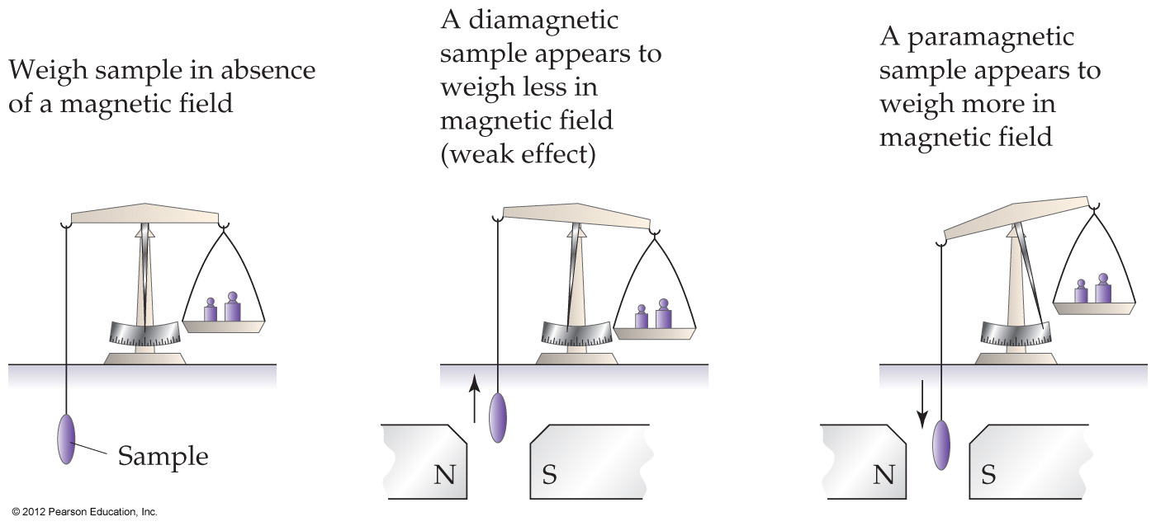
Magnetic Properties
Substance with no unpaired electrons are weakly repelled by a magnetic field. This property is called dimagnetism.
Substance with unpaired electrons are attracted to a magnetic field. This magnetic behavior is called paramagnetism.
Determining magnetic properties of a sample:

Slide 65
Example
Consider the O₂⁺ ion. (a) Draw its MO diagram. (b) Draw electron configuration of the ion in terms of its MOs. (c) Predict number of unpaired electrons and magnetic property. (d) Predict bond order and bond length.
Solution
O₂⁺ ion has 11 valence electrons.
(σ_{2s})²(σ*_{2s} )²(σ_{2p})²(π_{2p})⁴(π*_{2p})¹
one unpaired electron,
paramagnetic
(d) Bond order = ½(8 - 3) = 2½
Bond length is expected to be
between O₂ (1.21Å, bond
order 2) and N₂ (1.10Å, bond
order 3).
Notes:
The experimentally measured bond length for O₂⁺ is 1.123 Å

